Slide 1
Impacting your Community with Double Up Food Bucks
Notes:
SELF-INTRODUCTION

Slide 2
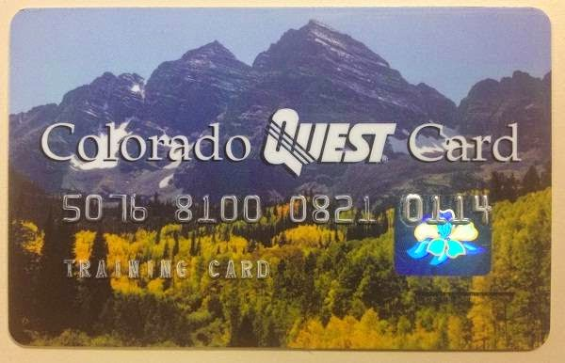
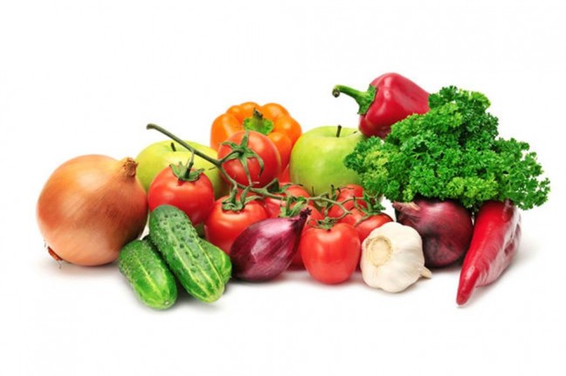
What is Double Up Food Bucks Colorado?
+
=

Slide 3
HEALTHY FOOD INCENTIVES
$1:$1 Match, Up to $20 per visit
What you can buy for $20 in SNAP benefits at one of our sites
What you can buy for $40 when SNAP is matched with Double Up Food Bucks
Notes:
I love these images because it helps provide a visual for the impact of the program by showing on the left, what consumers can by for $20 in SNAP benefits at a farmers market.
Compared to the one on the left, showing what can be purchased when a purchase is matched with an additional $20 in Double Up Food Bucks.
This means that consumer can bring home $40 worth of healthy food for $20.
3

Slide 4
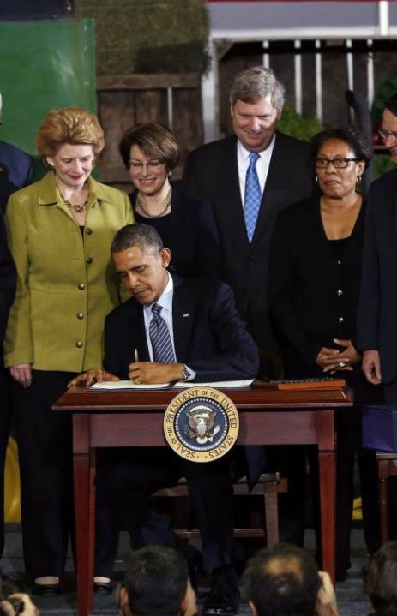
Food Insecurity Nutrition Incentive Program
2014 FARM BILL
$100 million over five years
Competitive grant program
Fruit and vegetable incentives for SNAP participants
All types of retail
Requires 1-1 match
Notes:
The Double Up experience in MI along with others programs across the country helped inform and inspire bi-partisan support for a new $100 million healthy food incentive grants program established in the 2014 Farm Bill.
The Food Insecurity Nutrition Incentive program is a competitive grant program.
• $100 million over year years (awards in 2015, 2016, 2017, 2018)
Fruit and vegetable incentives for SNAP participants
At all types of retail
Many kinds of groups are eligible to conduct programs
Grants require 1-1 match
This year, LiveWell Colorado along with 50 partners were granted a 2016 FINI grant, making this program possible in the state of Colorado!

Slide 5
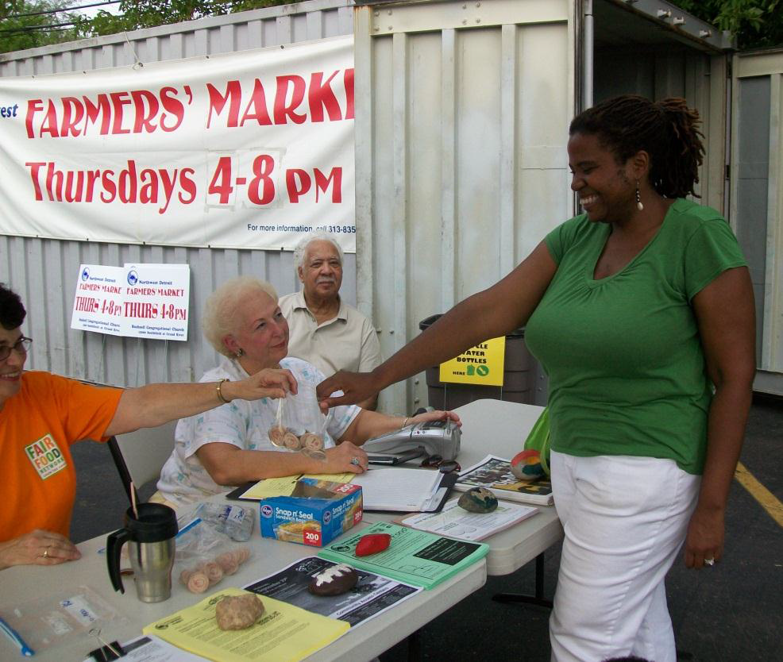
FAIR FOOD NETWORK
Pioneering
multi-win solutions to support farmers, families + local economies
Notes:
Fair Food Network, a non-profit based in Southeast MI first piloted Double Up Food Bucks in Detroit. Now, they work with programs all over the nation to help build incentive programs for fresh fruits and vegetables throughout the nation.
pro
5

Slide 6
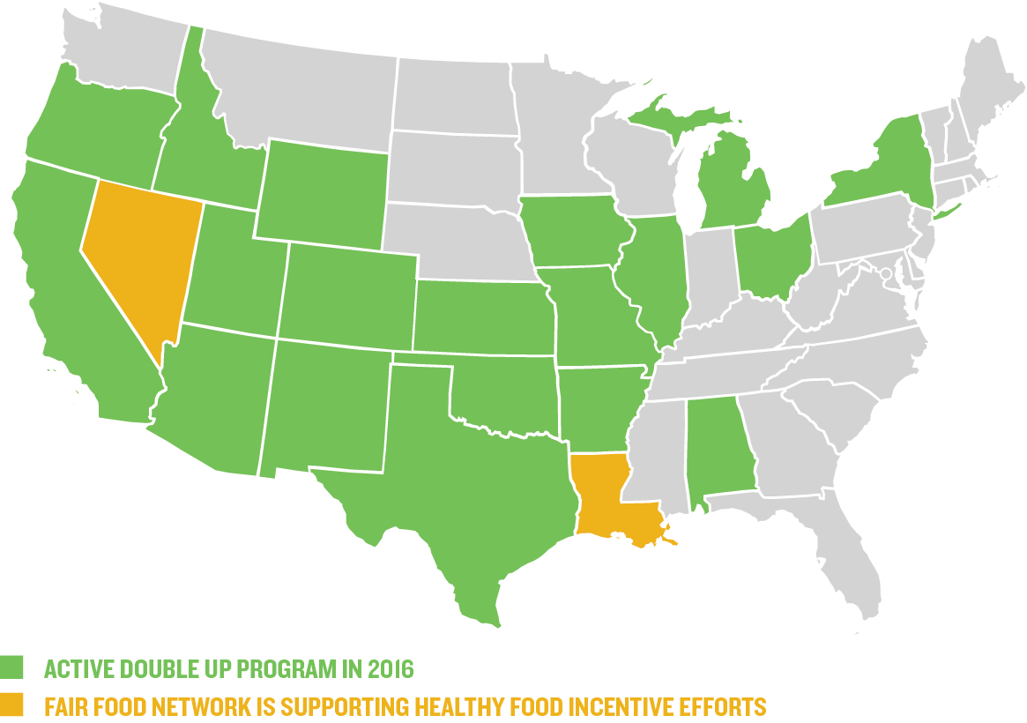
National Network

Slide 7
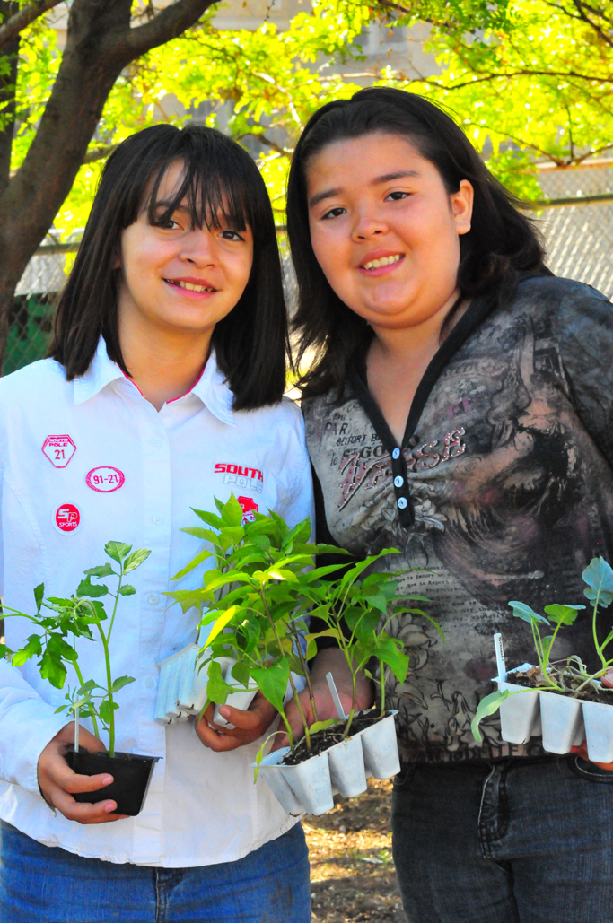
LiveWell Colorado
Vision: All Coloradans live in environments with equitable access to the nourishing food and physical activity they need to be healthy.
Mission: LiveWell Colorado increases access to healthy eating and active living by removing barriers that inequitably and disproportionately affect low-income communities and people of color.
Notes:
7

Slide 8
HEALTHY FOOD INCENTIVES
DOUBLE UP FOOD in Colorado
Over 90 sites in 28 different counties!
Notes:
I love these images because it helps provide a visual for the impact of the program by showing on the left, what consumers can by for $20 in SNAP benefits at a farmers market.
Compared to the one on the left, showing what can be purchased when a purchase is matched with an additional $20 in Double Up Food Bucks.
This means that consumer can bring home $40 worth of healthy food for $20.
8

Slide 9
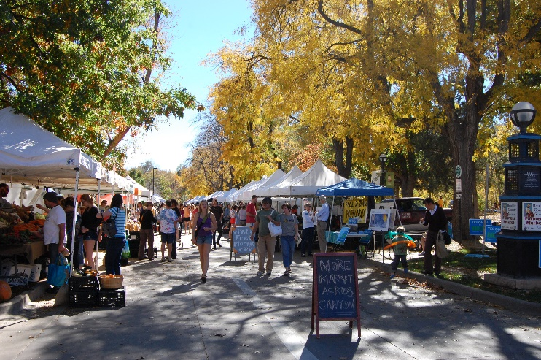
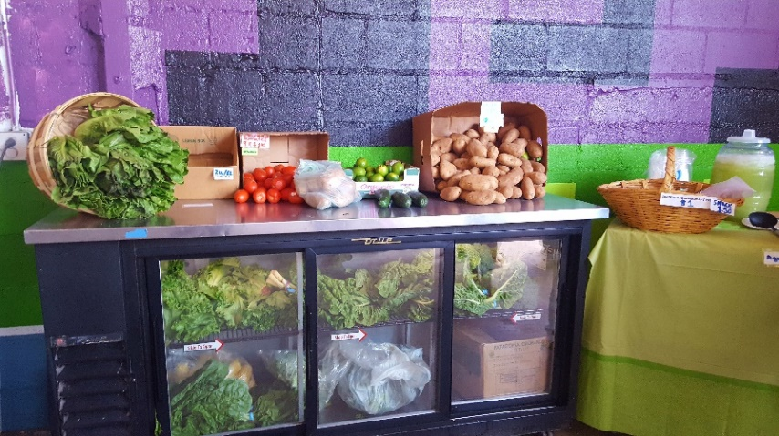
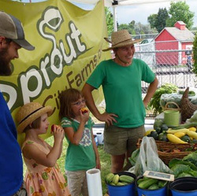
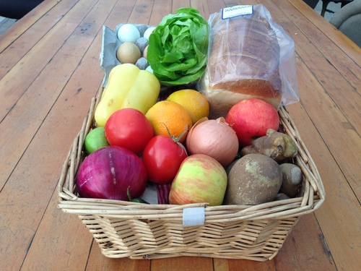
These sites included
Farmers Markets
Neighborhood Grocery
Farm Stands
Food Boxes/ CSA Shares
Notes:
Farmers Markets
Grocery Stores
Farmstands
Food Boxes
It is a myth that we are only in farmers markets! Our markets offer a lot of comnmunity benefits such a cooking demos, connection with farmers, health and wellness activities, etc. But this program can also be found at grocery stores, and other types of retail that are open more often and year round!
9

Slide 10
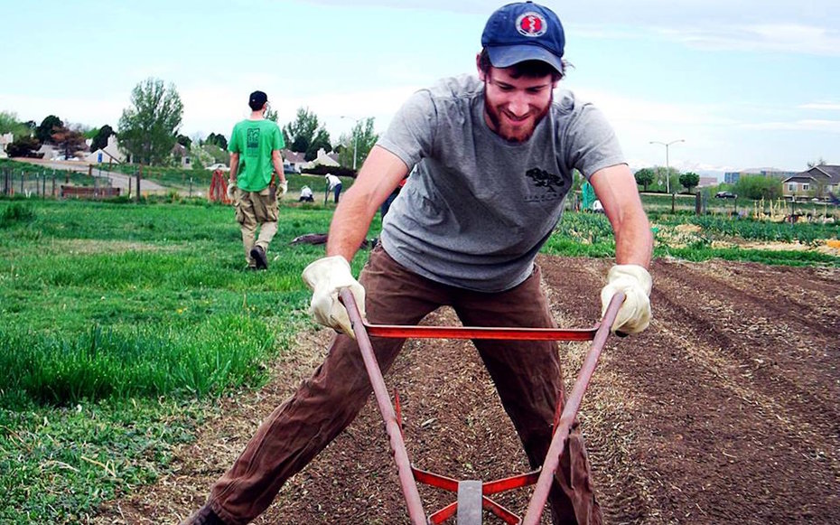
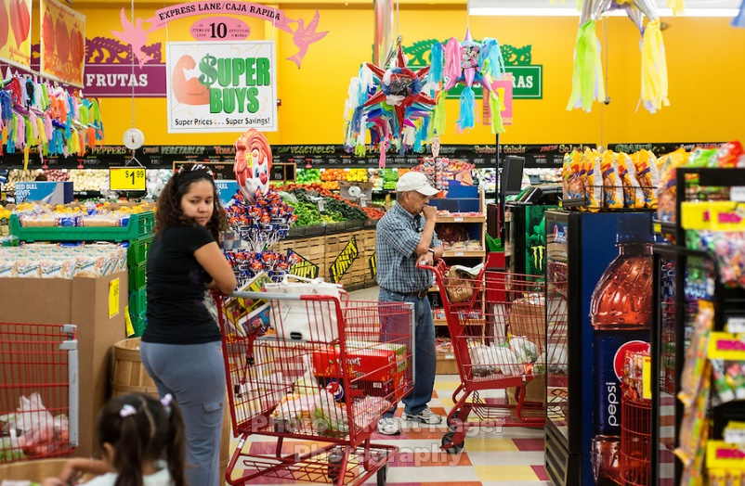
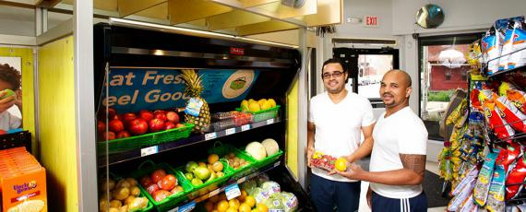
HEALTHY FOOD INCENTIVES
These sites included
Direct Market Farms
Lowes Mercado and Food King
Denver Healthy Corner Stores
Notes:
Farmers Markets
Grocery Stores
Farmstands
Food Boxes
It is a myth that we are only in farmers markets! Our markets offer a lot of comnmunity benefits such a cooking demos, connection with farmers, health and wellness activities, etc. But this program can also be found at grocery stores, and other types of retail that are open more often and year round!
10

Slide 11
How it Works Videos:
https://youtu.be/1-T_1h2IJSQ
https://youtu.be/4O8G_t-ssgc
Find these at doubleupcolorado.org
Notes:
Double Up Food Bucks does exactly this. The program doubles the value of federal nutrition benefits at participating farmers markets and grocery stores, helping people bring home more locally grown fruits and vegetables.
How does Double Up work?
Double Up provides SNAP-Recipients with a one-to-one match to purchase healthy, Colorado-grown fruits and vegetables when they use their EBT/Quest Card at participating locations.
Double Up makes it easier for low-income consumers to eat more fruits and vegetables while supporting family farms and growing local economies. We like to call it a win/win/win because families bring home more healthy food; farmers gain new customers and make more money; and more food dollars stay in the local economy.
And we also see a ripple effect of benefits from increased access to healthy food.
11

Slide 12
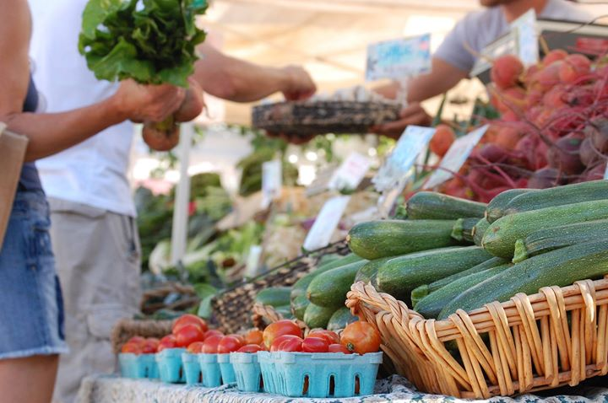
Why only fresh fruits and vegetables?
Most Expensive Calorically
Perception that it is expensive
Perception that healthy food is only for some people
Notes:
Double Up Food Bucks does exactly this. The program doubles the value of federal nutrition benefits at participating farmers markets and grocery stores, helping people bring home more locally grown fruits and vegetables.
How does Double Up work?
Double Up provides SNAP-Recipients with a one-to-one match to purchase healthy, Colorado-grown fruits and vegetables when they use their EBT/Quest Card at participating locations.
Double Up makes it easier for low-income consumers to eat more fruits and vegetables while supporting family farms and growing local economies. We like to call it a win/win/win because families bring home more healthy food; farmers gain new customers and make more money; and more food dollars stay in the local economy.
And we also see a ripple effect of benefits from increased access to healthy food.
12

Slide 13
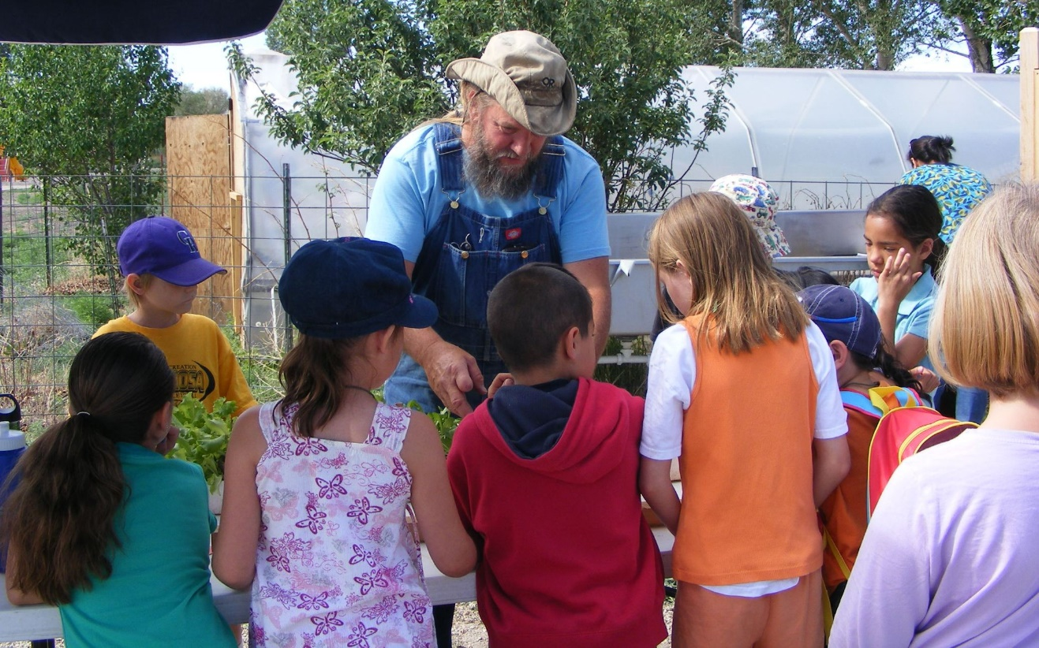
Why Local?
Bipartisan Support
Supporting Local Farmers
Allowing everyone to have access to their local food system
Notes:
Double Up Food Bucks does exactly this. The program doubles the value of federal nutrition benefits at participating farmers markets and grocery stores, helping people bring home more locally grown fruits and vegetables.
How does Double Up work?
Double Up provides SNAP-Recipients with a one-to-one match to purchase healthy, Colorado-grown fruits and vegetables when they use their EBT/Quest Card at participating locations.
Double Up makes it easier for low-income consumers to eat more fruits and vegetables while supporting family farms and growing local economies. We like to call it a win/win/win because families bring home more healthy food; farmers gain new customers and make more money; and more food dollars stay in the local economy.
And we also see a ripple effect of benefits from increased access to healthy food.
13

Slide 14
Double Up by the Numbers

Slide 15
Who are our customers?
https://fns-prod.azureedge.net/sites/default/files/ops/Colorado.pdf

Slide 16
Impact on Community
Customer Survey Question | n | Response
As a result of DUFB I buy more F/V | 211 | 88% Agree or Strongly Agree
As a result of DUFB I eat more F/V | 207 | 87% Agree or Strongly Agree
I am visiting the market today because of DUFB | 181 | 75% Agree or Strongly Agree
“This is amazing program I am so excited to use this. With food prices going up it's very hard to buy healthy and fresh fruit and veggies this will help my family greatly!!! Thank you double up”
- Colorado Springs resident

Slide 17
Customer Feedback
“I like eating fresh, organic, local fruits and vegetables. Being on the SNAP program, I don't have a lot of money, it helped me to eat healthier. A lot of times I could get local organic foods at the grocery store and I would do that. Without the Double Up coupons I would've had a hard time using it because the farmer's market is pretty expensive. I go the Wednesdays because, even if they don't have as many vendors as Saturday, it's not as crowded. I really don't like crowds.”
“I would always love to have more fresh fruits and vegetables in my life. If I could afford more, I'd put more resources towards that. It was satisfactory the amount I could use every week. Before, I still went to the farmer's market, but I wouldn't purchase as many of them. Otherwise I'd go to a regular supermarket and buy what I could when I could. I like to source things more seasonally. It's allowed me to expand my horizons for fruits and vegetables that I use. Before double up my fruit and vegetable intake was simple salads, squash in the Winter. With the program, I could try new things as well. ”
Notes:
Double Up Food Bucks does exactly this. It is FFN’s flagship program and Michigan’s statewide healthy food incentive program. The program doubles the value of federal nutrition benefits at participating farmers markets and grocery stores, helping people bring home more locally grown fruits and vegetables.
How does Double Up work?
Double Up provides SNAP-Recipients with a one-to-one match to purchase healthy, Michigan-grown fruits and vegetables when they use their Bridge Card at participating locations.
Double Up makes it easier for low-income consumers to eat more fruits and vegetables while supporting family farms and growing local economies. We like to call it a win/win/win because families bring home more healthy food; farmers gain new customers and make more money; and more food dollars stay in the local economy.
And we also see a ripple effect of benefits from increased access to healthy food.
17

Slide 18
Help Double Up Food Bucks Grow and Flourish

Slide 19
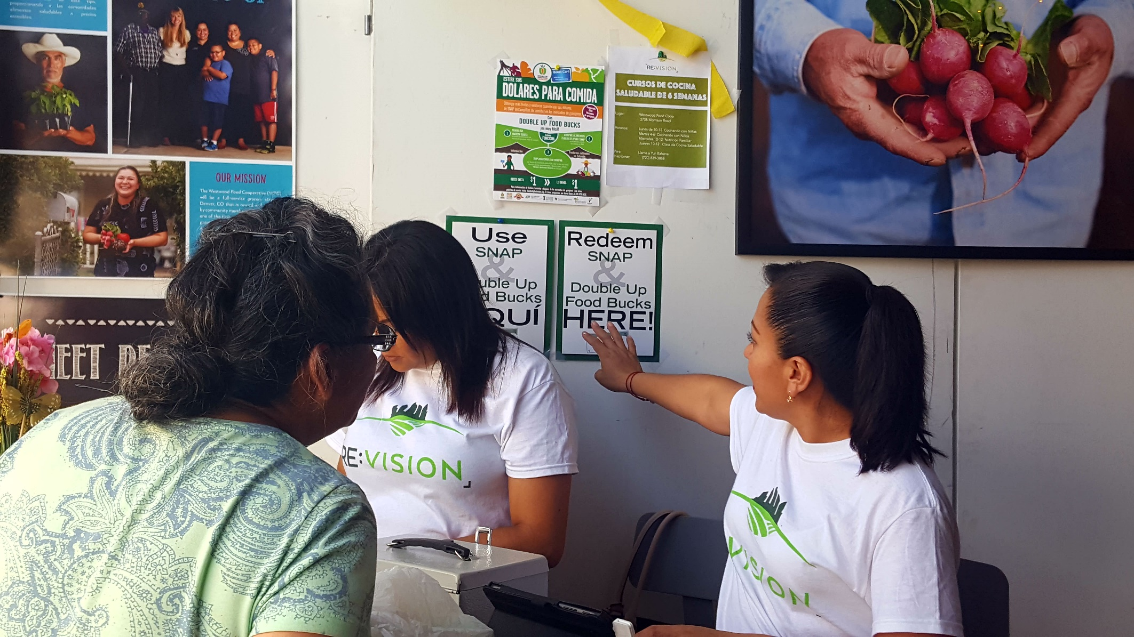
Help Us Spread the Word
Notes:
Investment in an integrated and dynamic communications campaign utilizing a variety of strategies.
We design a variety of outreach materials including a outreach campaign to consumers centrally coordinated by Fair Food Network and engage in a wide network of partnering agencies including statewide networks and local community organizations.
19

Slide 20
Find out where to refer and order materials:
Where? https://doubleupcolorado.org/locations/
Receive Resources:
https://doubleupcolorado.org/resources/

Slide 21
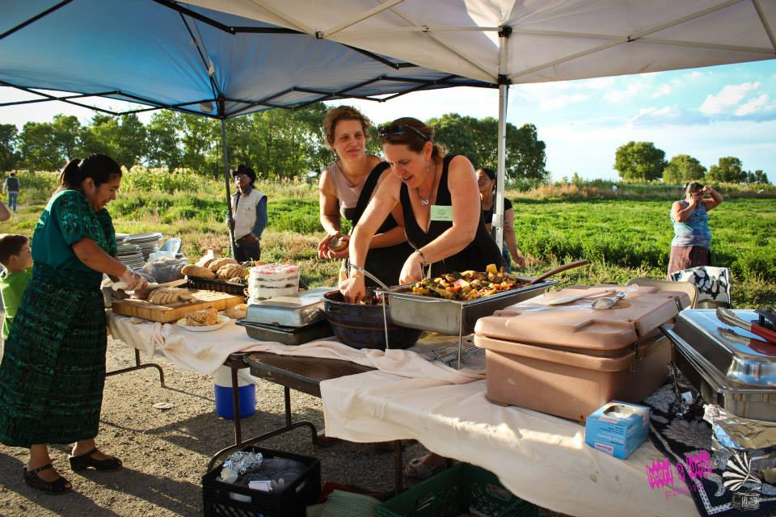
Connect us to local partners
Notes:
Investment in an integrated and dynamic communications campaign utilizing a variety of strategies.
We design a variety of outreach materials including a outreach campaign to consumers centrally coordinated by Fair Food Network and engage in a wide network of partnering agencies including statewide networks and local community organizations.
21

Slide 22
For more info contact Amy Nelms, Food Access Coordinator, at amynelms@livewellcolorado.org or at 720-573-3632

Slide 23
Thank you for supporting Double Up Colorado, Healthy Food Access, and Local Economies in Colorado!

